Slide 1

DEPARTMENT OF ARTIFICAL INTELLIGENCE AND DATA SCIENCE
Project Review
“A Hybrid Neural Network for EEG-based Depression Screening Using CNN+LSTM”
Project Team Members
Name USN
B.LATHA SREE 1SJ22AD006
C S MOUNIKA 1SJ22AD008
M.CHARAN 1SJ22AD024
Project Guide
Badrinath K
Assistant Professor
Dept of AI&DS, SJCIT
2025-26
1

Slide 2

A Hybrid Neural Network for EEG-based Depression Screening Using CNN
TABLE OF CONTENTS
Abstract
Introduction
Objectives
Methodology
Architecture
Results
Conclusion
Dept of AI&DS, SJCIT
2025-26
2

Slide 3
A Hybrid Neural Network for EEG-based Depression Screening Using CNN
ABSTRACT
Depression is a widespread psychological disorder affecting people of all ages. Early diagnosis is crucial, and EEG signals can help assess mental health. A fully automated Depression Detection System using a novel Hybrid Neural Network, DepHNN, which combines CNN for temporal learning and LSTM for sequence learning. EEG data from 34 depressed and 30 normal drug-free individuals were used. The system achieves 98.27 accuracy and a MAE of 0.0237, offering an efficient, accurate, and low-complexity solution for EEG-based depression screening.
Dept of AI&DS, SJCIT
2025-26
3

Slide 4
A Hybrid Neural Network for EEG-based Depression Screening Using CNN
INTRODUCTION
Depression affects over 322 million people worldwide, with a higher incidence among females. Although it is a treatable condition, nearly half of the cases remain undiagnosed due to factors like limited awareness, insufficient resources, and incorrect diagnoses. EEG signals, being non-invasive and cost-effective, serve as valuable biomarkers for identifying neurological disorders, including depression. However, their complexity makes manual analysis challenging. A hybrid LSTM-CNN model (DepHNN) for efficient and accurate detection of depression using EEG data.
Dept of AI&DS, SJCIT
2025-26
4

Slide 5
A Hybrid Neural Network for EEG-based Depression Screening Using CNN
OBJECTIVES
Develop a CNN-LSTM model for automated depression detection using EEG signals.
Improve adaptability using Hold-Out Validation and diverse datasets.
Apply regularization techniques such as L2 regularization and adaptive learning rate optimization.
Enhance model accuracy and generalization using dropout, data augmentation, and early stopping.
Minimize computational complexity and latency to enable real-time depression screening on portable and cloud-based platforms.
Dept of AI&DS, SJCIT
2025-26
5

Slide 6
A Hybrid Neural Network for EEG-based Depression Screening Using CNN
METHODOLOGY
1. Data Collection
Used EEG dataset from Figshare (19-channel, eyes-closed).
Total subjects: 34 Depressed + 30 Healthy.
2. Preprocessing
Bandpass filtering (0.5–45 Hz).
Removed artifacts using ICA. Applied Z-score normalization.
Segmented signals into 1-second windows with 50% overlap.
3. Model Development
Built a Hybrid CNN-LSTM model (DepHNN) using TensorFlow.
CNN extracts spatial features, LSTM captures temporal patterns.
Dense layers classify: Healthy vs Depressed.
4. Deployment
Backend: Django with authentication + OTP login.
Frontend: Responsive UI with real-time Chart.js plots.
Integrated trained model for instant prediction on uploaded EEG (.edf) files.
Dept of AI&DS, SJCIT
2025-26
6

Slide 7
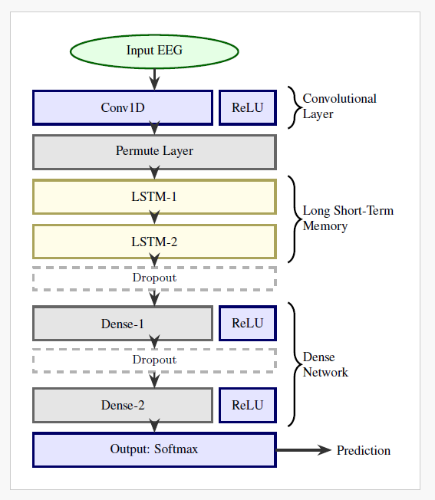
A Hybrid Neural Network for EEG-based Depression Screening Using CNN
ARCHITECTURE
Dept of AI&DS, SJCIT
2025-26
6

Slide 8
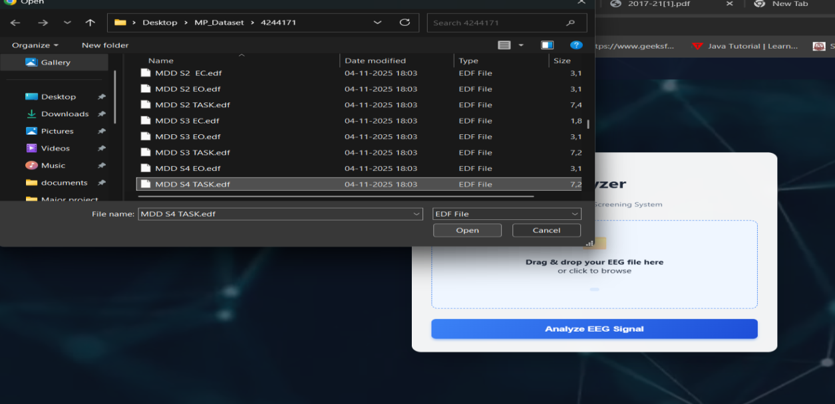
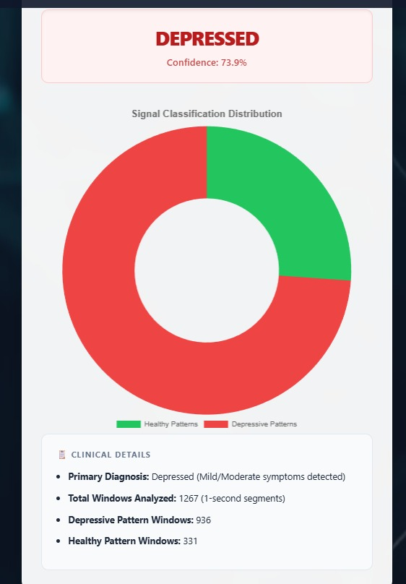
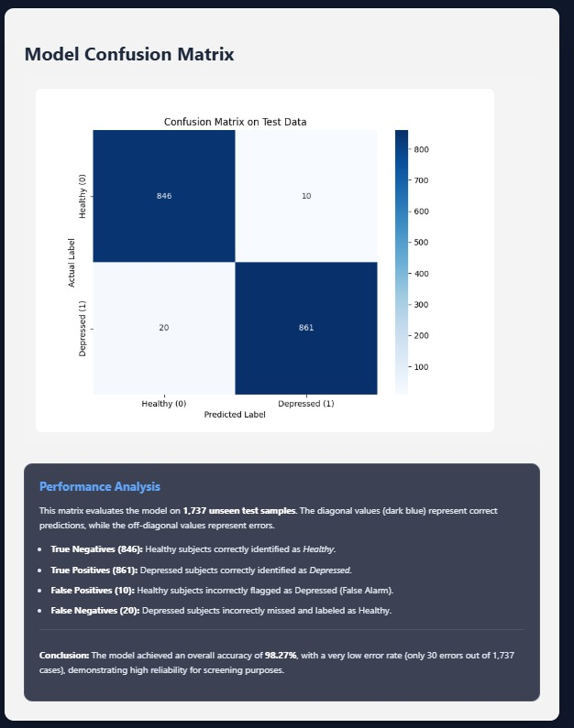
A Hybrid Neural Network for EEG-based Depression Screening Using CNN
RESULTS
.
Dept of AI&DS, SJCIT
2025-26
7

Slide 9
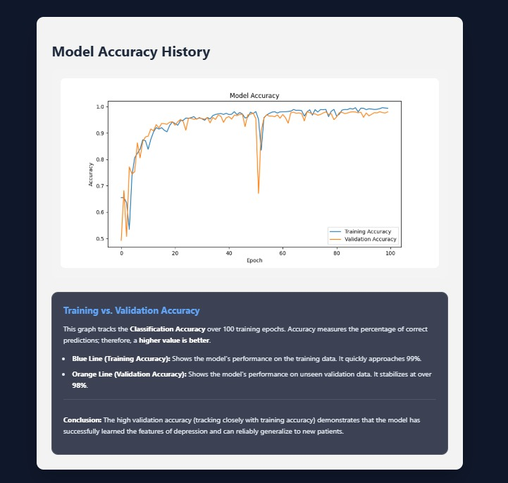
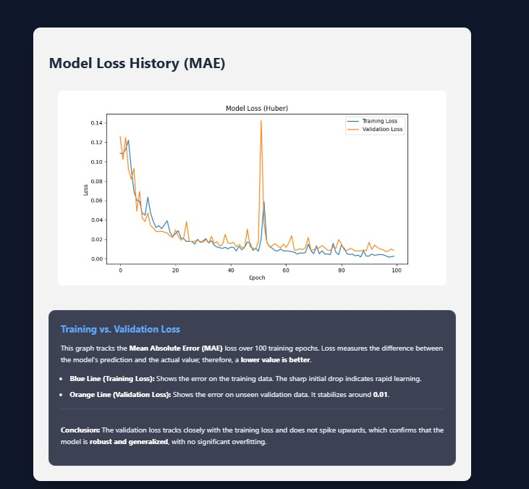
A Hybrid Neural Network for EEG-based Depression Screening Using CNN
Dept of AI&DS, SJCIT
2025-26
8

Slide 10
A Hybrid Neural Network for EEG-based Depression Screening Using CNN
CONCLUSION
DepHNN is a hybrid deep learning model combining CNN and LSTM for automated depression detection using EEG signals. It efficiently extracts temporal and sequential features without manual engineering and achieves high accuracy with minimal error and computation time. The model surpasses existing approaches in accuracy, efficiency, and robustness, making it a reliable computer-aided tool for early depression screening. Future improvements can enable severity analysis, use of larger datasets, and integration with IoMT systems for real-time mental health monitoring.
Dept of AI&DS, SJCIT
2025-26
9

Slide 11

Dept of AI&DS, SJCIT
2025-26
9

